Slide 1
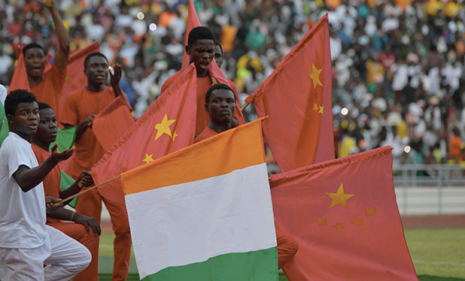
Great Decisions 2021
America’s largest foreign affairs education & discussion program. Now in its 67th year!
CHAPTER 5 China in Africa

Slide 2
China’s Recent History in Africa
1955 – Formation of Non-Aligned Movement offering non-Western support against colonial/neo-colonial control in Africa
1960s – Premier Zhou Enlai toured Africa and articulated principles of China’s foreign policy that remain today:
Non-interference in domestic affairs of partners
South-South solidarity and shared victimization by West
TAZARA Railway as a template for future development cooperation (focused on infrastructure) that fit well with the Pan-African Socialism of Tanzania’s Julius Nyerere & Zambia’s Kenneth Kaunda.

Slide 3
The TAZARA Railway (AKA TANZAM & UHURU)
The 1,800-km rail line, built 1971-75, allowed Zambian copper to reroute from White-ruled Southern Africa to independent Tanzania’s port of Dar es Salaam.
Britain, Japan, West Germany, World Bank, the U.S. and UN all declined to fund the project.
China’s largest foreign aid project at the time ($406 Mil or $2.7 Bil in 2020).

Slide 4
Forum on China-Africa Cooperation (FOCAC)
2000 – 1st meeting, repeating every 3 years
Participation requires accepting One China Policy (eSwatini--AKA Swaziland--only holdout)
Cooperation projects are largely bilateral, thus uneven
2006 – FOCAC elevated to Summit (attended by heads of state). China offered $5 bil in concessional loans and opened China-Africa Development Fund (CADF) capitalized at $1 bil
2009 – Concessional loans ↑ $10 bil. China became Africa’s largest trading partner.
2012 – Concessional loans ↑ $20 bil, CADF ↑ to $5 bil
2015 & 2018 – Concessional loans ↑ $60 bil

Slide 5
Other Forms of China’s Involvement
Peacekeeping – As of August 2020, China had 2,531 solders under UN command (largely in Africa), the world’s ninth largest contributor overall and largest among the five permanent members of the Security Council.
Infrastructure – Financing for ports and railways in support of African Continental Free Trade Agreement (AfCFTA, 2019) to counter colonial counter-development which resulted in intra-continental trade <15%
Education – China has established Confucius Institutes for language and culture studies at African Universities. China is now the primary destination for African studies abroad, surpassing France and more than U.S. & U.K. combined.
2013 Belt and Road Initiative (BRI) – Promoting export-led growth, which transformed China

Slide 6
BRI’s “Five Connectivities”
Infrastructure connectivity
Free trade
Financial integration
Policy coordination
People-to-people exchange

Slide 8
Contrasting Development Models
WESTERN | CHINESE
Led by Private Sector | Centrally-planned
Builds on education & health, democracy, rule of law, and transparent public institutions | Builds on infrastructure to support export-led growth →Port-Park-City model of industrial development
Economies are stagnant, inequality growing | Highest rates of economic growth by any country
Tainted by colonialism and continuing racism | Successfully overcame imperialism

Slide 9
U.S.-Africa Foreign Policy Recommendations
Rather than challenging China directly, seek to rebuild U.S.-Africa relations based on areas of strength:
Education – Encourage return of African students to U.S. universities with easier visa access and financial support
Debt – Support further U.S. private-sector debt relief and continue push for further G20 relief
Services – Focus development support on service sector and civil society rather than challenge China’s infrastructure focus
Media diplomacy and diaspora outreach – Build on popularity of America media and engage African diaspora in the U.S.
Technology – Support matchmaking between tech sectors in African countries with Silicon Valley firms seeking to diversify tech alternatives

