Slide 1
Cloud Storage

Slide 2
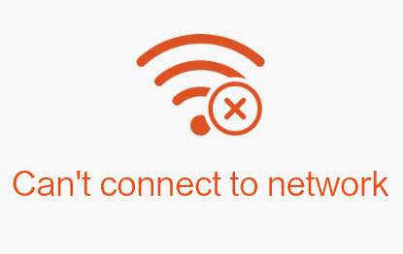

What is the Cloud?
OR
OK
IA
GA
NC

Slide 3
Paid Version of G-Suite - TOS
7.1 Intellectual Property Rights. Except as expressly set forth herein, this Agreement does not grant either party any rights, implied or otherwise, to the other’s content or any of the other’s intellectual property. As between the parties, the Customer owns all Intellectual Property Rights in the Customer Data, and the Application or Project (if applicable), and Google owns all Intellectual Property Rights in the Services and Software.
Free Version - TOS
Your Content in our Services
Some of our Services allow you to upload, submit, store, send or receive content. You retain ownership of any intellectual property rights that you hold in that content. In short, what belongs to you stays yours.
When you upload, submit, store, send or receive content to or through our Services, you give Google (and those we work with) a worldwide license to use, host, store, reproduce, modify, create derivative works (such as those resulting from translations, adaptations or other changes we make so that your content works better with our Services), communicate, publish, publicly perform, publicly display and distribute such content. The rights you grant in this license are for the limited purpose of operating, promoting, and improving our Services, and to develop new ones. This license continues even if you stop using our Services (for example, for a business listing you have added to Google Maps). Some Services may offer you ways to access and remove content that has been provided to that Service. Also, in some of our Services, there are terms or settings that narrow the scope of our use of the content submitted in those Services. Make sure you have the necessary rights to grant us this license for any content that you submit to our Services.
Our automated systems analyze your content (including emails) to provide you personally relevant product features, such as customized search results, tailored advertising, and spam and malware detection. This analysis occurs as the content is sent, received, and when it is stored.
If you have a Google Account, we may display your Profile name, Profile photo, and actions you take on Google or on third-party applications connected to your Google Account (such as +1’s, reviews you write and comments you post) in our Services, including displaying in ads and other commercial contexts. We will respect the choices you make to limit sharing or visibility settings in your Google Account. For example, you can choose your settings so your name and photo do not appear in an ad.
You can find more information about how Google uses and stores content in the privacy policy or additional terms for particular Services. If you submit feedback or suggestions about our Services, we may use your feedback or suggestions without obligation to you.

Slide 4
 | Dropbox | Google | OneDrive | iCloud
Initial Storage | 2 GB free | 15 GB free | 15 GB free | 5 GB free
Pricing-What does it cost above and beyond? | 1 TB=$9.99/month Unlimited=$15/month | 100 GB=$1.99/month 1 TB=$9.99/month | 100 GB=$1.99/month 200 GB=$3.99/month | 20 GB=$.99/month 200 GB=$3.99/month 500 GB=$9.99/month 1 TB=$19.99/month
PC Integration-Does it work with your computer? Which operating system? | Free sync apps with Windows and Mac | Free sync apps with Windows and Mac | Windows sync built in. Free sync app for Mac | Mac OS X sync built in. Free sync app for Windows
App Availability | iOS, Android, Windows | iOS, Android, Windows desktop only | iOS, Android, Windows desktop only | Integrated into iOS apps
Document Editing | Many third party apps, offers Microsoft products for new documents(if owned) | Google Docs, Sheets and Slides | Microsoft Word, Excel and Powerpoint | Apple Pages, Numbers and Keynote
More in depth Lynda.com classes | Up and Running with Dropbox | Google Drive Essential Training | Up and Running with OneDrive | iCloud Essential Training

Slide 5
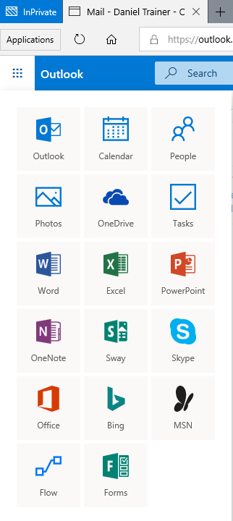
If you have an Outlook.com, Hotmail.com or MSN.com email you have access to a suite of Microsoft Products

Slide 6
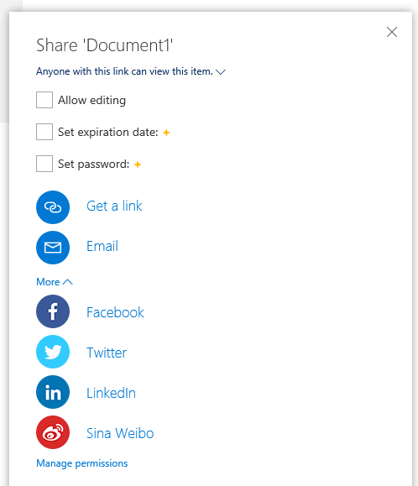
Creating and Sharing a document
Create or upload a document.
Select the Document and choose SHARE from the menu
Select how you want to share the document

Slide 7
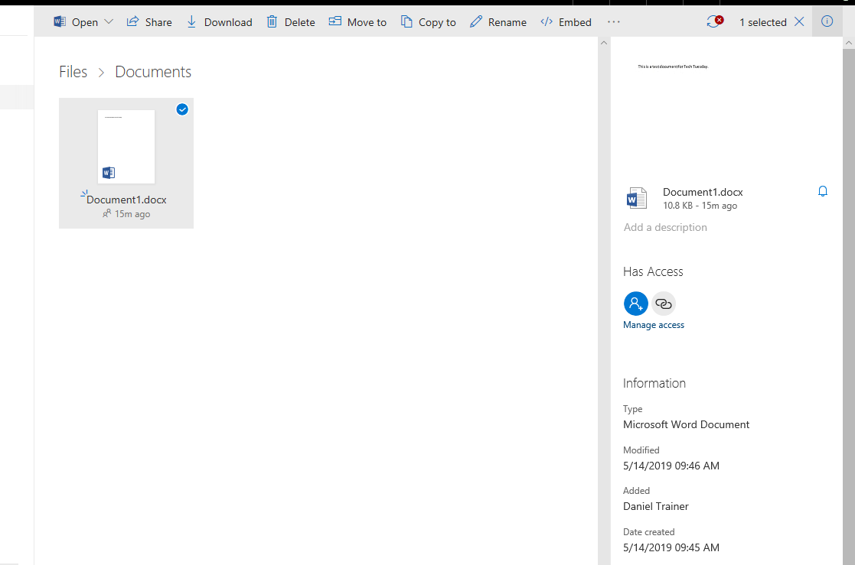
Once Shared you can manage access options for the document

Slide 8
Resources:
Google Data Centers
  https://www.google.com/about/datacenters/
Google Backup and Sync
  https://www.google.com/drive/download/backup-and-sync/
Google Terms of Service
  https://policies.google.com/terms?hl=en&gl=UShttps://www.microsoft.com/en-us/servicesagreement

Slide 9
LifeWire Comparison of Cloud Services
  https://www.lifewire.com/a-comparison-of-free-cloud-storage-services-1356941
Dropbox Terms of Service
  https://www.dropbox.com/terms2016
iCloud Terms of Service
  https://www.apple.com/au/legal/internet-services/icloud/en/terms.html
Understanding the Cloud:
  https://edu.gcfglobal.org/en/computerbasics/understanding-the-cloud/1/

